Slide 1
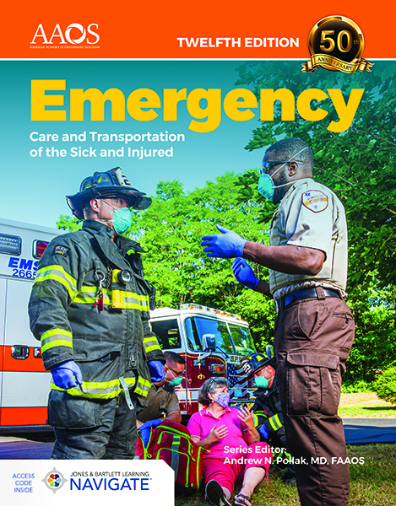

Celebrating 50 Years of EMS Innovation
Source Code: EMT12JC

Slide 2
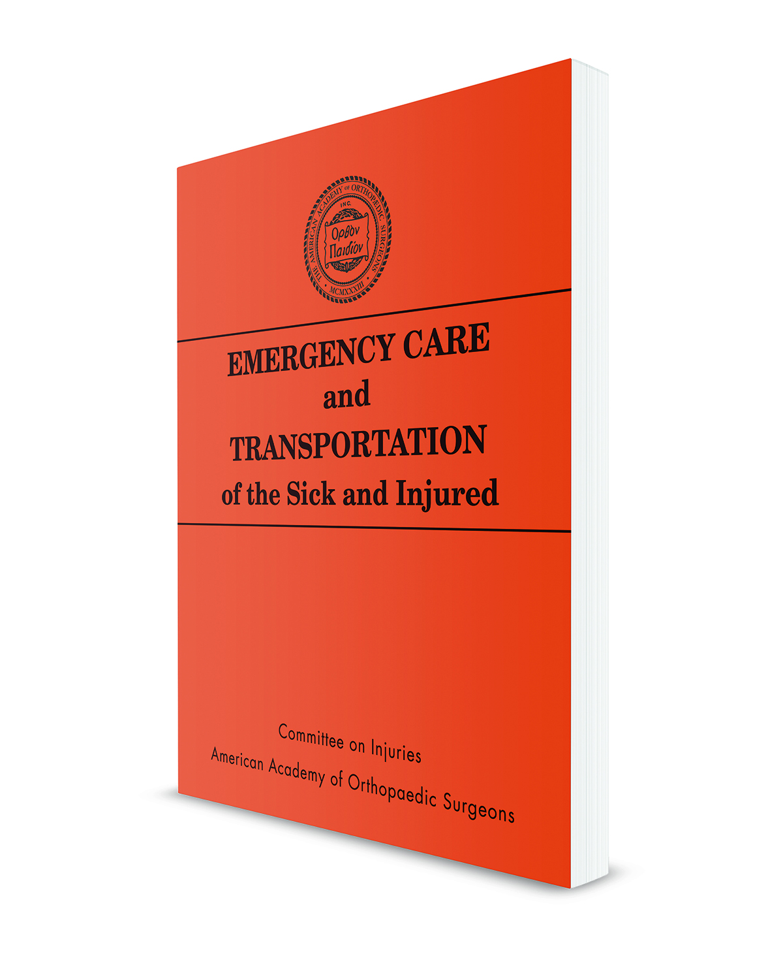
Since 1971, Emergency Care and Transportation of the Sick and Injured has advanced how EMS education is delivered to help train exceptional EMS professionals around the globe.
Fifty years later, the Twelfth Edition is now the most comprehensive, innovative EMT educational solution ever developed.

Slide 3
What’s New in the
Twelfth Edition

Slide 4
Current State-of-the-Art Medical Content
The Twelfth Edition delivers the latest medical evidence and alignment to current standards, along with a revised layout to improve readability.

Slide 5
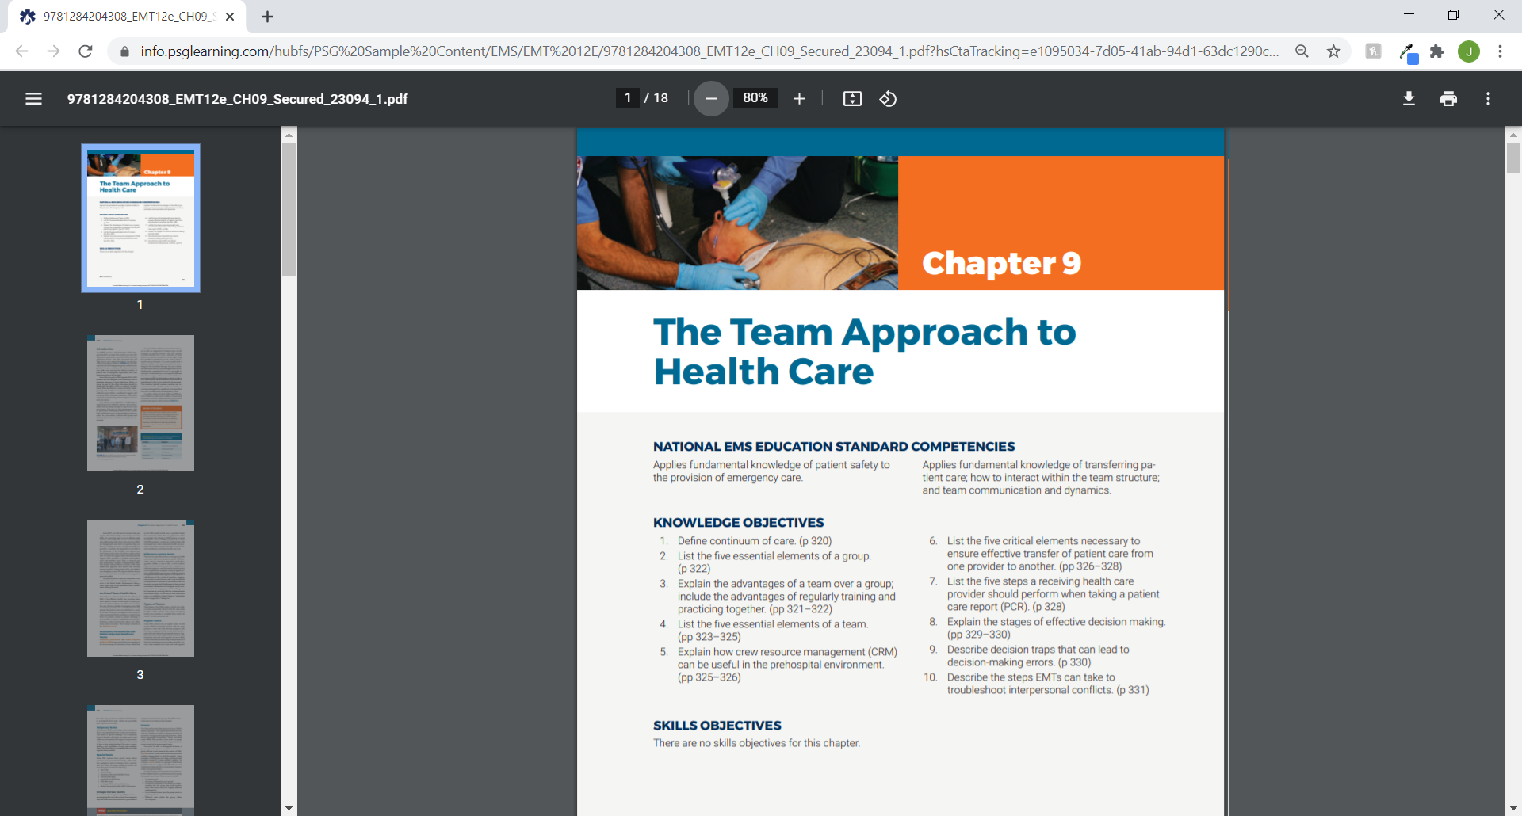
Comprehensive coverage of the latest National EMS Education Standards

Slide 6
Comprehensive coverage of the 2020 ILCOR Treatment Recommendations and AHA ECC Guidelines

Slide 7
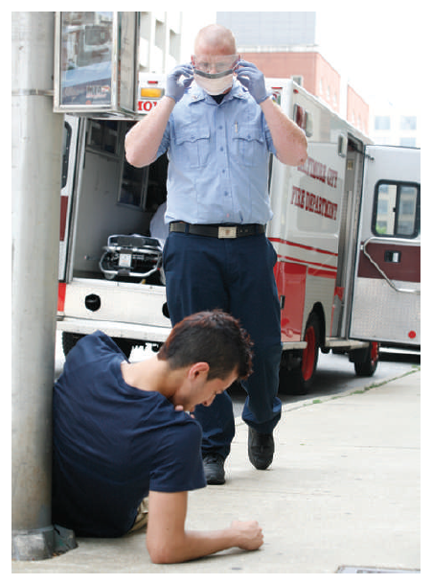
Updated coverage of PPE and CDC guidelines for safe patient care during the
COVID-19 pandemic

Slide 8
The textbook design and layout have been revised to improve visualization of key content and overall readability

Slide 9
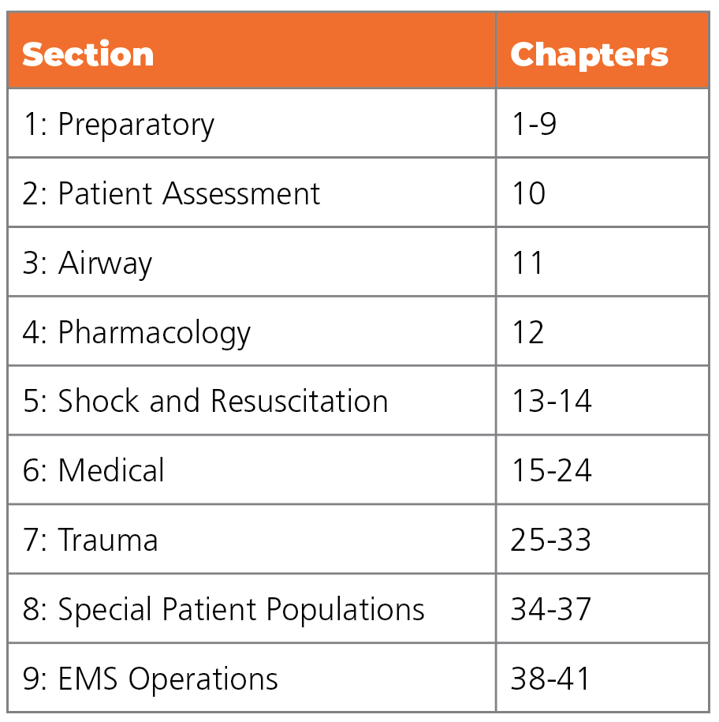
The text is broken up into nine sections for ease of learning

Slide 10
A Focus on Career Readiness and Employability
For those who care about more than just pass rates,
the Twelfth Edition is devoted to addressing the most
common job readiness issues reported by employers.

Slide 11
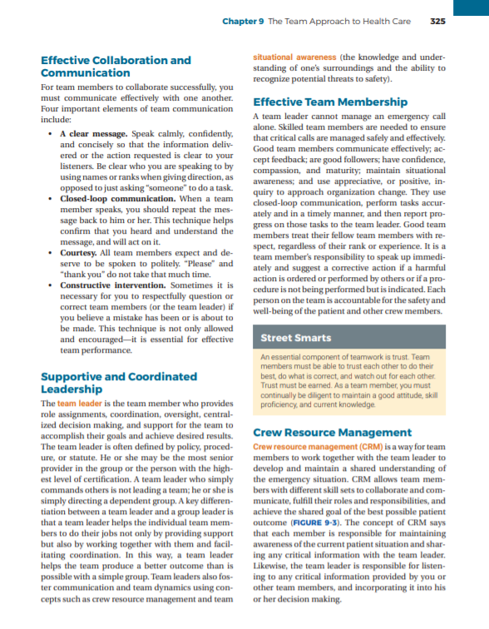
Greater emphasis on empathy, teamwork, interpersonal skills, and problem solving to ensure students are well prepared as they transition into the field

Slide 12
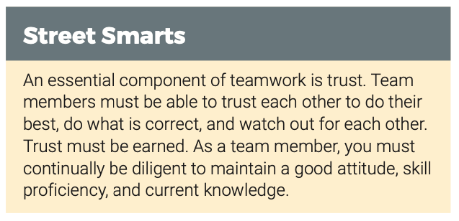
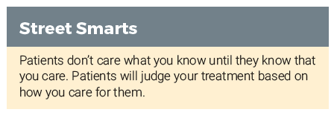
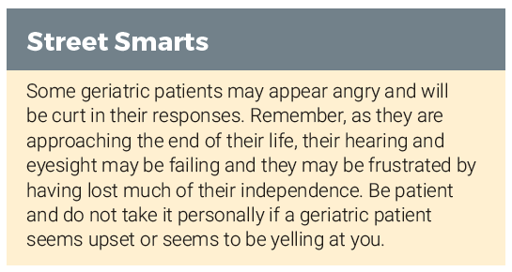
A new “Street Smarts” feature that helps bridge the gap between the classroom and field environment by addressing nontechnical skills that improve patient and co-worker interactions

Slide 13
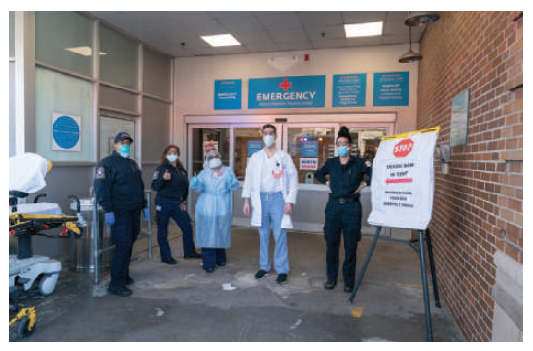
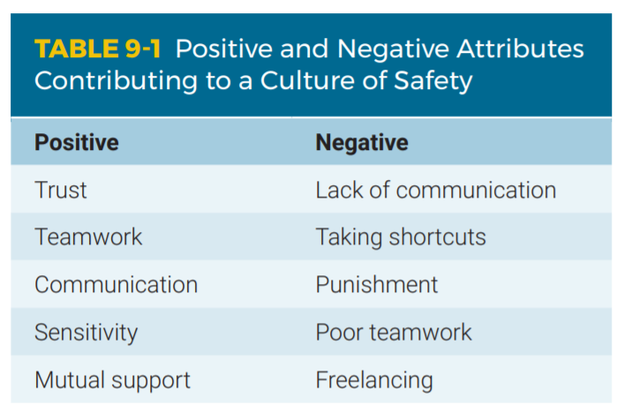
Enhanced content on provider mental health, wellness, and safety

Slide 14

Soft Skills for EMS Providers, a series of interactive scenarios, provide techniques that can be used to improve overall critical thinking, communication, and teamwork

Slide 15
Innovative and Flexible Package Options
Helpful student resources like an audiobook, interactive lectures, simulations, and videos drive value and cater to a variety of learning styles and needs. Educators are supported by a range of instructional and
assessment resources to simplify course delivery.

Slide 16

Premier
Navigate Package Options
Advantage
Essentials
High-quality materials to meet core content and instruction needs
Foundational resources that prepare students for the National Registry Exam and the field
Hybrid Classroom
A comprehensive education solution that facilitates student engagement and virtual learning
Flipped Classroom
An integrated suite of resources
that transforms the traditional classroom into a student-directed learning environment

Slide 17
Navigate Package Comparisons
Customize your package
by adding select student
learning materials:
Fisdap Scheduler
Fisdap Skills Tracker
Fisdap Exams (Multiple Available)
Interactive Lectures
Soft-Skill Simulations
Student Workbook

Slide 18
View a free sample chapter or place your order today:
http://go.psglearning.com/EMT12e

Slide 19
Please contact your dedicated
Public Safety Specialist today: psglearning.com/contact
Questions?

